Slide 1
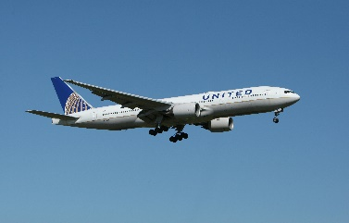
High Cloud Airlines Analysis
Prepared By :
RITIN TARPADA

Slide 2
Contents:
1. Overview
2. List of KPI’s
3. Dashboard
4. Insights
5. Recommendations
6. Conclusion

Slide 3
Overview
High Cloud Airlines aims to provide exceptional travel experience while prioritizing sustainability and innovation.
Customer satisfaction by offering personalized services, including flexible booking options.
Committed to providing a safe and secure environment for our passengers .
Offer a wide range of domestic and international routes, connecting major cities and popular travel destinations.

Slide 4
List of KPI’s
1) Load Factor percentage on a yearly, Quarterly, Monthly basis
A high load factor indicates a preferred airline with most seats sold.
2) load Factor percentage on a Carrier Name basis
Analyzed the total number of passengers traveling with each airline.
Identified the top 5 carrier names based on passenger count.
3) Identify Top 10 Carrier Names based on passengers preference
Southwest Airlines Co. stands out significantly with the highest passenger count of 8018
This suggests it is the most preferred airline by a large margin.
4) Display top Routes based on Number of Flight
The data is sorted in descending order, with the most popular route being Chicago, IL to Detroit, MI with 93 flights.
5) Identify the how much load factor is occupied on Weekend vs Weekdays.
The pie chart shows that the load factor is occupied on Weekdays 71% of the time and on Weekends 29% of the time.
This suggests that the load factor is more heavily used during the week, possibly due to factors such as business hours or school schedules
6) Identify number of flights based on Distance group
This KPI shows the number of flights based on distance group.
We can see that the number of flights decreases as the distance increases. Shorter flights are more common: People are more likely to take shorter flights for business trips , visiting family and friends.

Slide 5
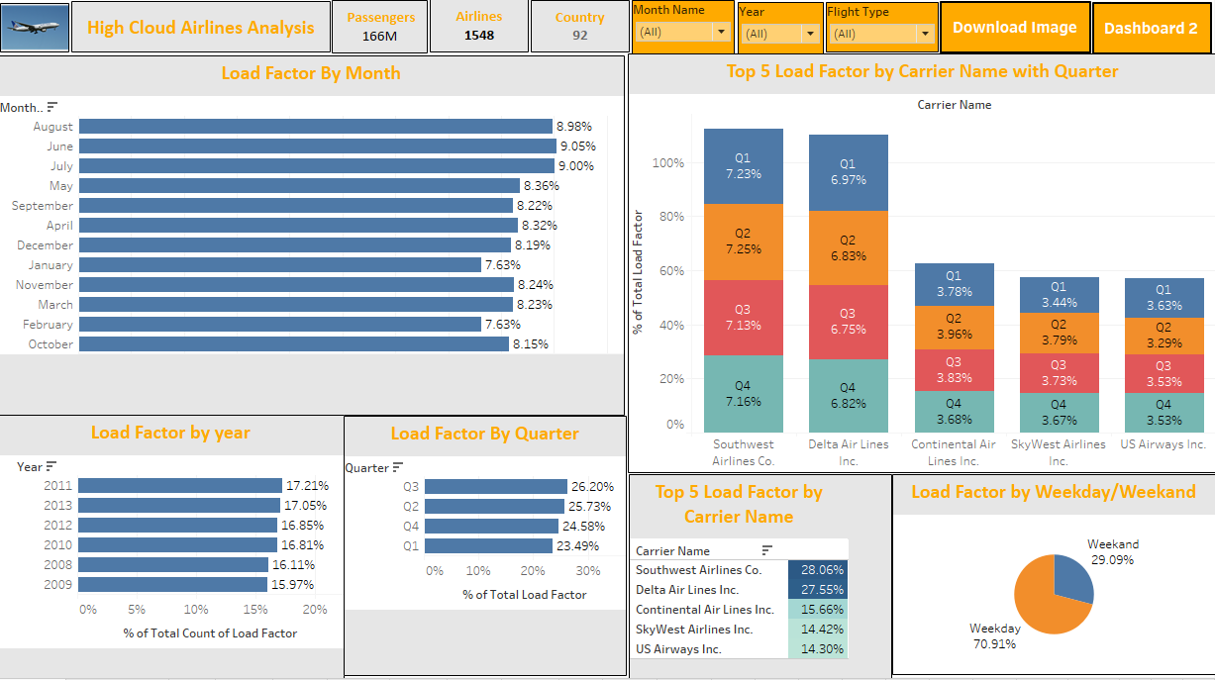
Tableau Dashboard :

Slide 6
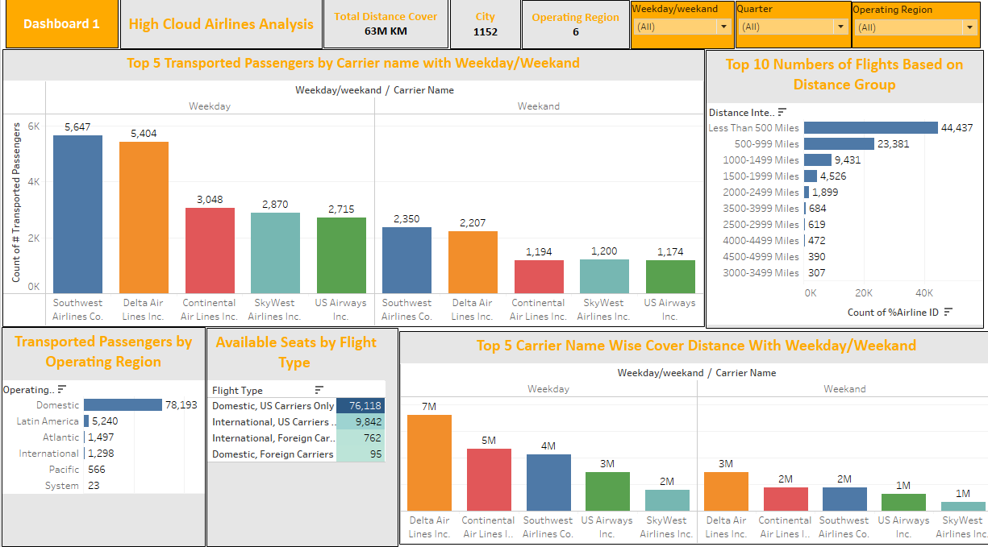
Tableau Dashboard :

Slide 7
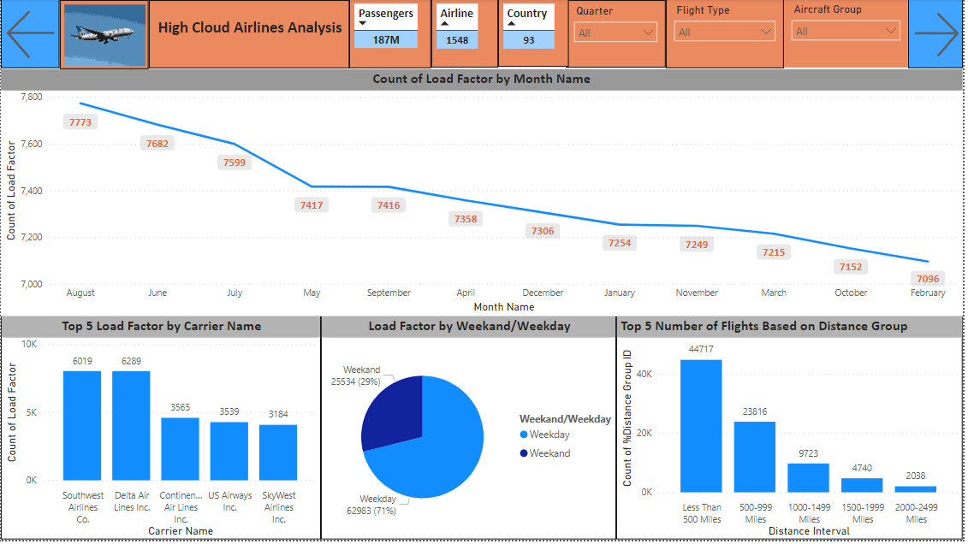
Power BI Dashboard :

Slide 8
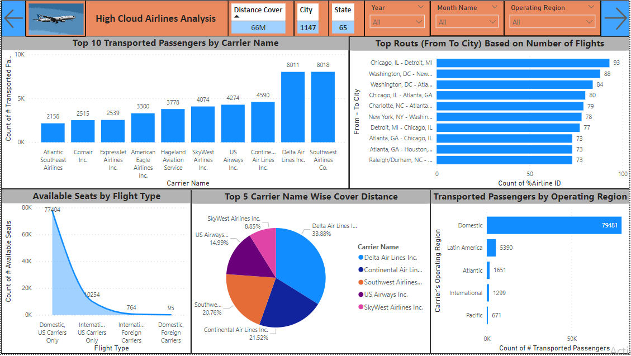
Power BI Dashboard :

Slide 9
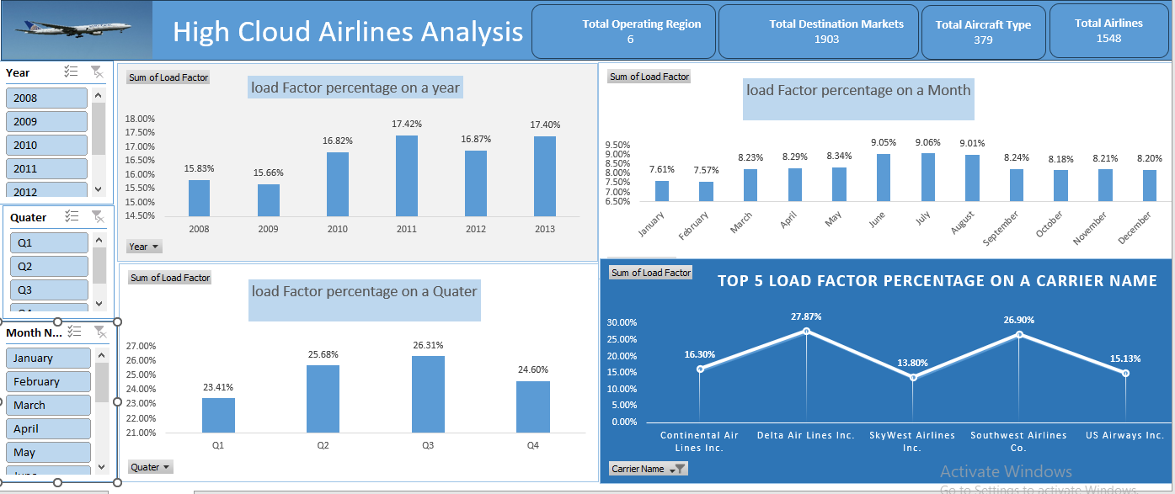
Excel Dashboard

Slide 10
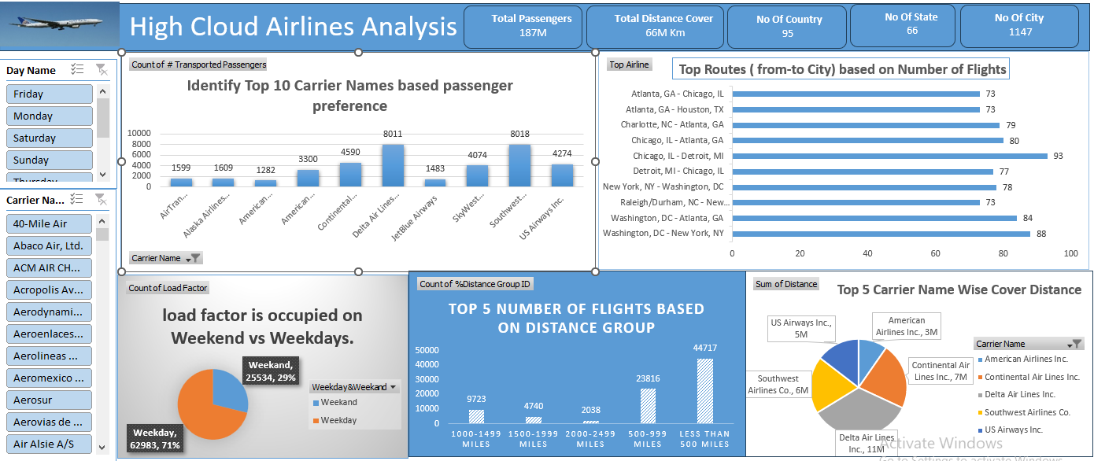
Excel Dashboard

Slide 11
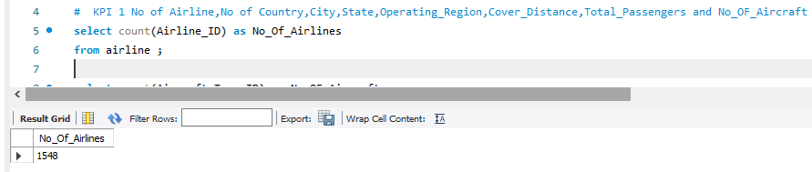
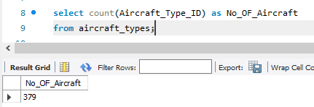
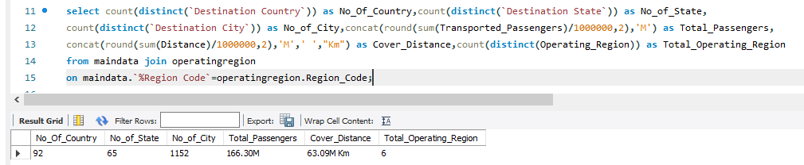
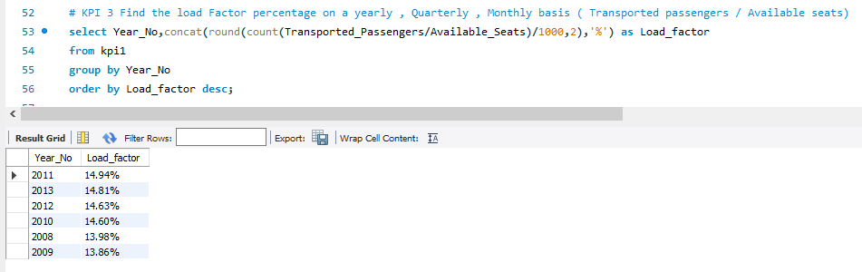
SQL Work

Slide 12
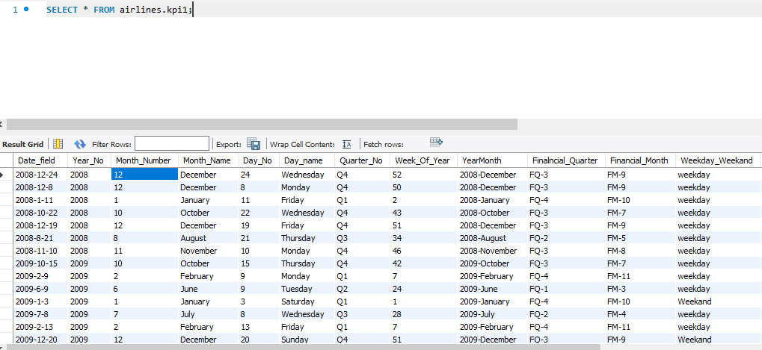
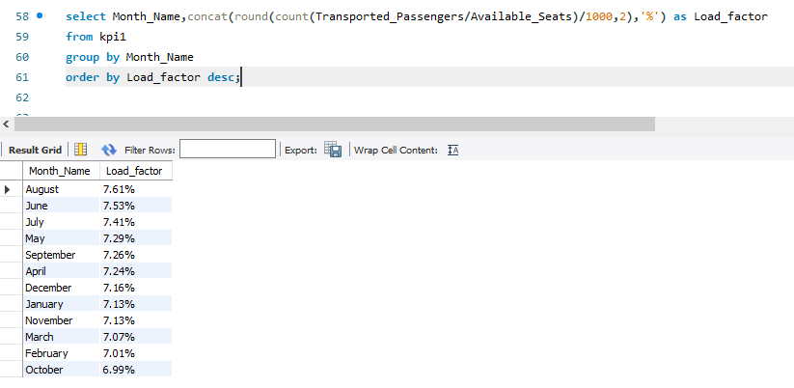
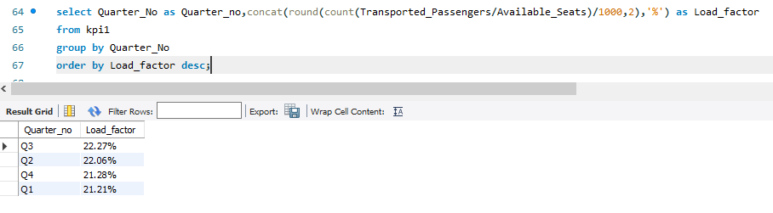
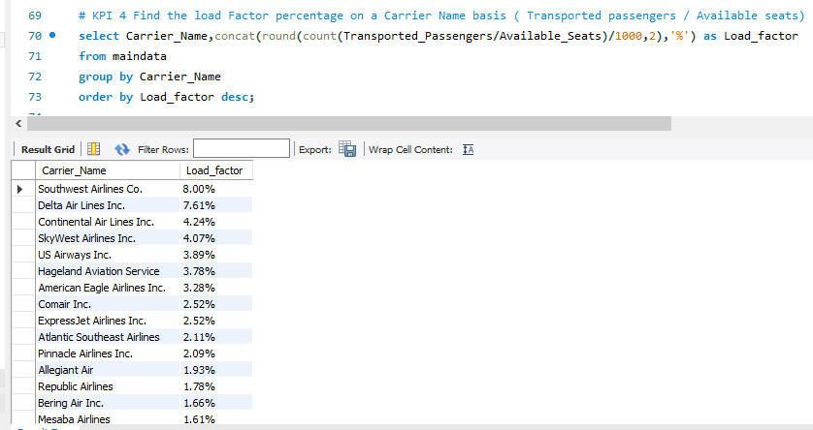
SQL Work

Slide 13
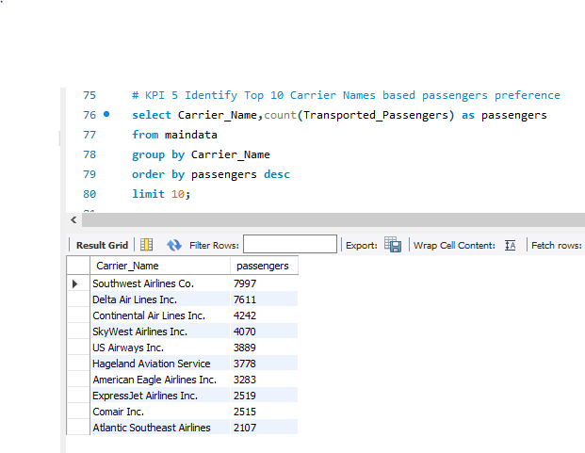
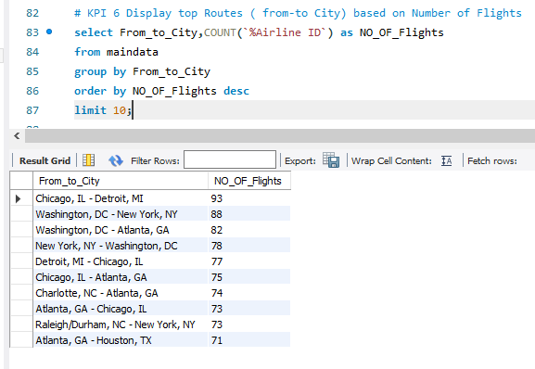
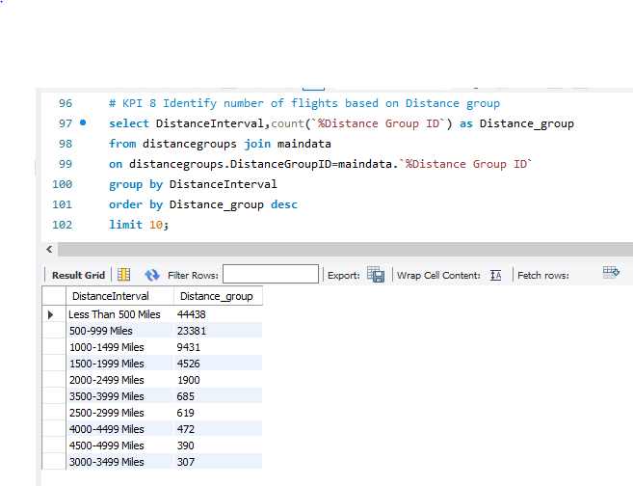
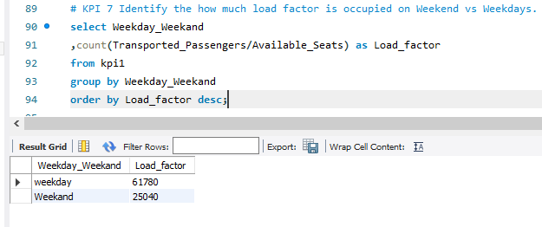
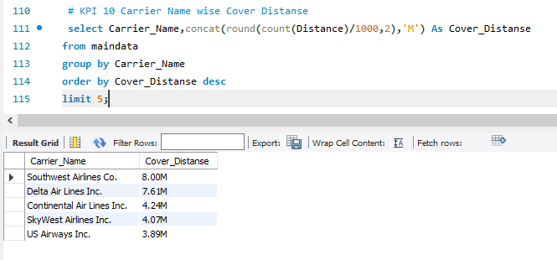
SQL Work

Slide 14
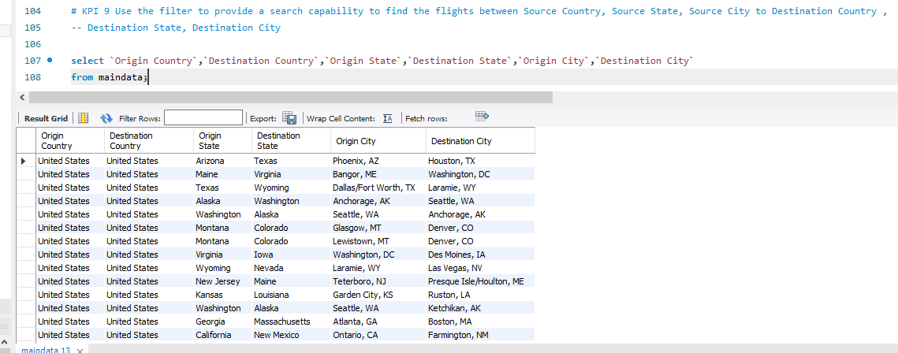
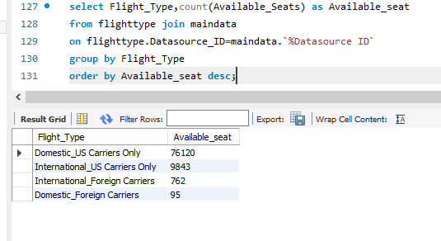
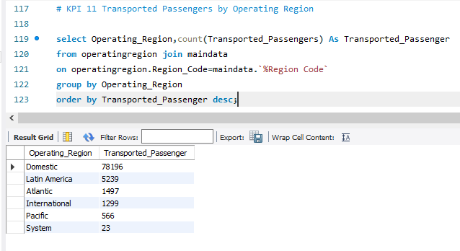
SQL Work

Slide 15
Insights
Identifying underserved markets and expanding international routes can drive growth.
Focusing on popular tourist destinations while also exploring emerging markets can diversify revenue streams.
Collaborating with eco-friendly brands and services can enhance the travel experience

Slide 16
Recommendations
Utilize insights from up routes and flights to Optimize schedule and resource allocation.
Allocate resources based on flight schedules and passenger volume data. This ensures efficient operation and minimizes wait times at airports with high passenger traffic.
Leverage load factor analysis to identify trends and implement strategies for increased efficiency.

Slide 17
Conclusion
High Cloud Airlines aims to expand its route network while maintaining a focus on safety and reliability.
Airline is well-positioned to navigate future industry dynamics and continue delivering value to its customers and stakeholders
By harnessing the power of data, we can drive positive changes, ensuring a bright future for High Cloud Airlines and its partners in the aviation sector.

Slide 18
Thank You

